Slide 1
North Point Company: Model Development
By: Mrunal Mahakala

Slide 2
Introduction
North Point makes gaming and educational software.,
To expand their customer base, they teamed up with other companies to share customer lists and send targeted mailings.
This offers unique opportunities for its members to use its pool of customer lists, which enhances the potential targeted mailing to customers and predictive modeling.

Slide 3
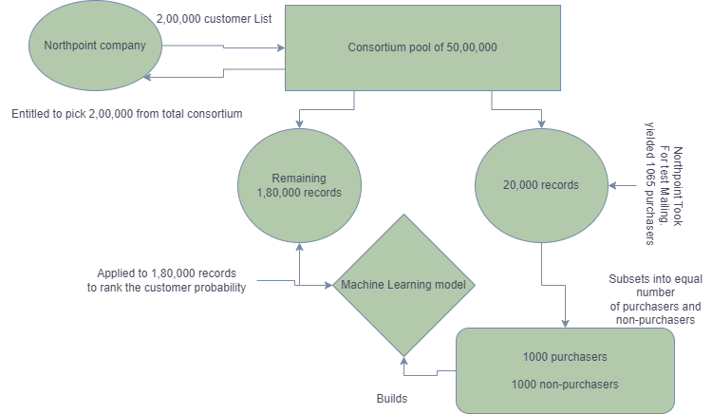
Problem Statement and Business Goal
Analyze dataset to rank top customers
Improve company’s gross margin profit by targeting potential customers effectively

Slide 4
Exploratory Data Analysis
Take Aways From Distribution Graphs:
source e and a are majority.
Spending distribution is high between 100 and 200. with an average spend of $202.88 per customer.
Mail order outnumber web order
Frequency distribution is between 0 and 5.
Non-residential addresses show higher distribution,

Slide 5
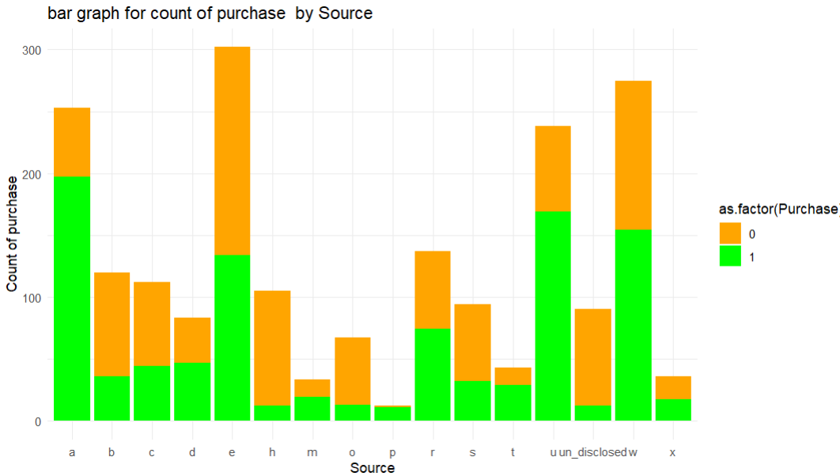
Exploratory Data Analysis
Gender does not significantly influence purchase decisions, indicating by an equal distribution between genders.
Spending VS Purchase: A strong relationship, with most purchases falling between $0 and $500.
Frequency vs. Spending: Majority of customers exhibit low purchase frequency and spending, with occasional high spend purchases.
Source vs. Purchase: Distribution of sources and purchasers highlights the contribution of different sources to purchases.

Slide 6
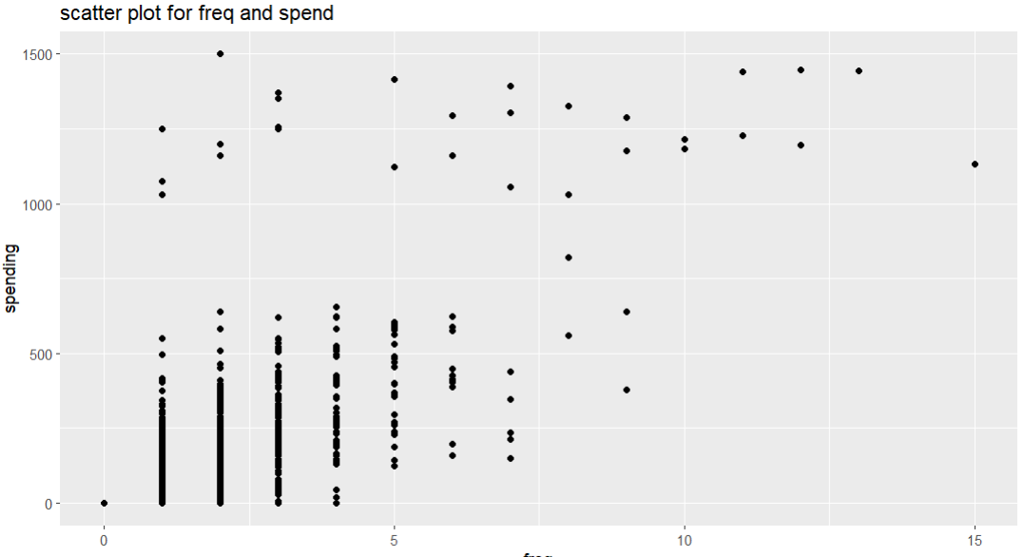
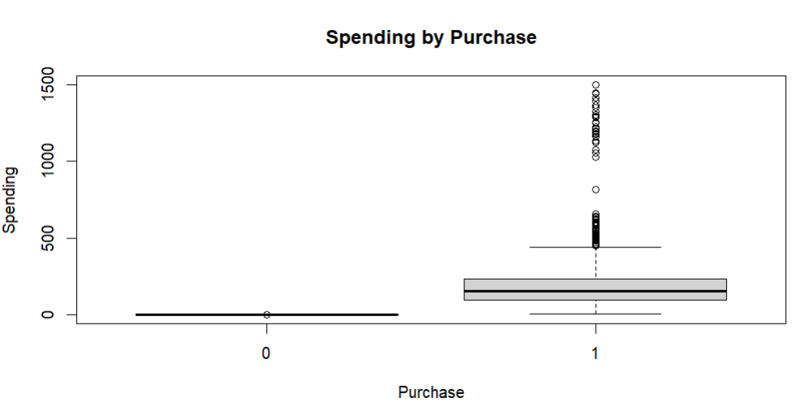
Exploratory Data Analysis

Slide 7
Classification Models Probability of Purchase
Partitioning:
40% training,35% Validation,25% Holdout data.
Machine learning model:
logistic regression: finding probability of purchase and impacting attributes.
naïve Bayes : the variables are independent of each other

Slide 8
Classification Model Comparision
Model(columns) Evaluation metrics(rows) | Naïve Bayees | Logistic Regression | Logistic Regression Forward stepwise | Logistic Regression Backward step wise
Accuracy | 69% | 79% | 78.51% | 79.29%
sensitivity | 0.67 | 0.79 | 0.80 | 0.7938
specificity | 0.71 | 0.78 | 0.77 | 0.7919
By considering sensitivity as our important metric for selecting a model The Forward step-wise model is a good option for classification or predicting the probability of purchase.

Slide 9
Prediction of Customer Spend Using Regression
Regression Model is developed only on purchased
Regression model:
Linear Regression: (USED)
Backward:
Front
Regression Tree
 | Correlation | RMSE | MAE
Linear Regression | 0.63 | 159.28 | 104.88
Linear Regression with Forward | 0.63 | 160.33 | 105.34
Linear Regression with Backward | 0.63 | 160.33 | 105.34
Regression tree | 0.57 | 166.47 | 101.48

Slide 10
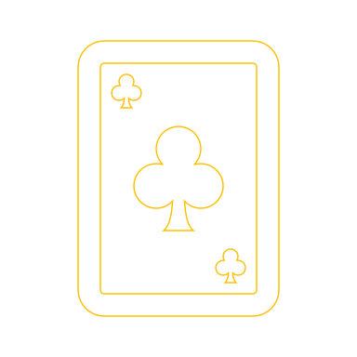
Applying on Holdout set
Prediction of Purchase Probability:
Utilized the classification model to predict the probability of purchase for customers in the holdout dataset.
Created a new column named "Predicted Purchase" to store the predicted probabilities.
Adjusted the probabilities by multiplying with 0.15 to account for over sampling non-purchasers as the response rate of 20,000 customers.
Prediction of Spending:
Applied a backward linear model to predict spending for purchasers in the holdout dataset.
Added a new column named "Predicted Spending" to the holdout dataset.
Rescaled predicted spending by multiplying with the adjusted probability of purchase

Slide 11
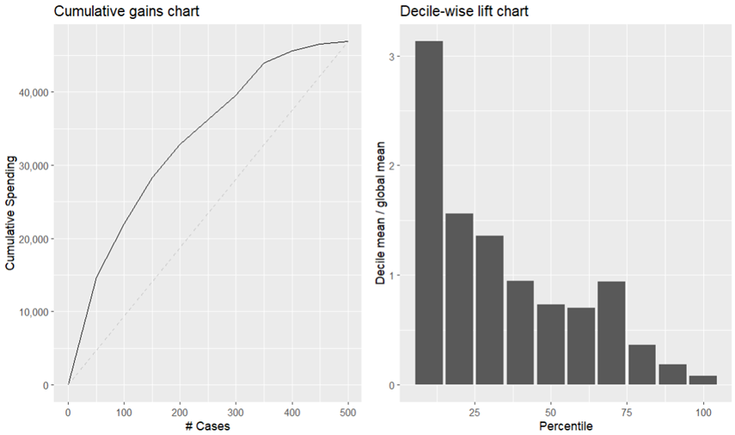
Recommendations
Using those models, we can effectively identify the top 10 percent of purchasers from the entire records, which is 1,80,000 customers. These 10 percent purchasers are predicted to generate three times more gross profit compared to others.
The business can first focus on top 10% customers and after achieve their goals focus on top 25% etc. To increase their customers.

Slide 12
Questions?

